Slide 1
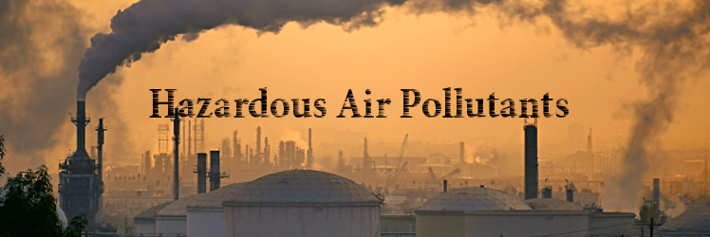
Hazardous Air Pollutants in USA from 1990 to 2017 Analysis
Group 6
Krishna Ghorpade
Songyun Qian
Himani Patel
Shahnawaz Khan

Slide 2
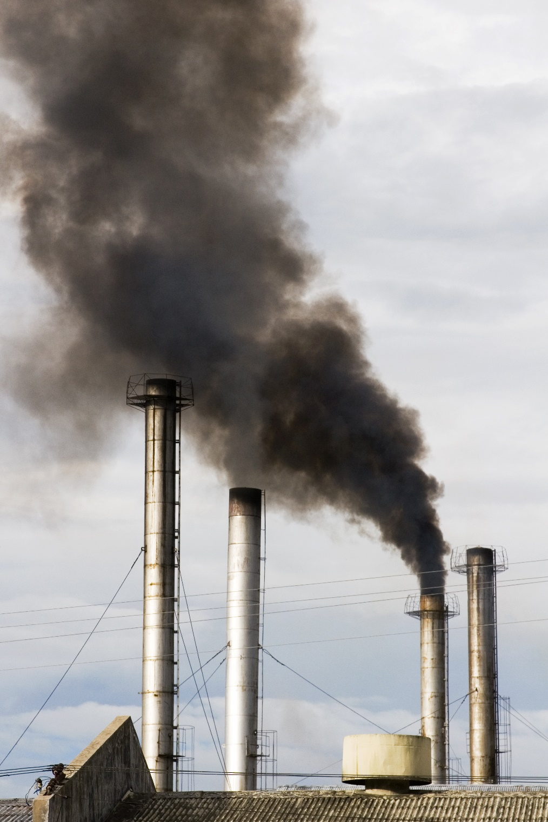
Table of Content
Introduction
Specification and Perquisites
Goals and Objectives
Implementation
Data loaded into BigInsights
Create Hive table
Visualization
Challenges
Conclusion
Links and References

Slide 3
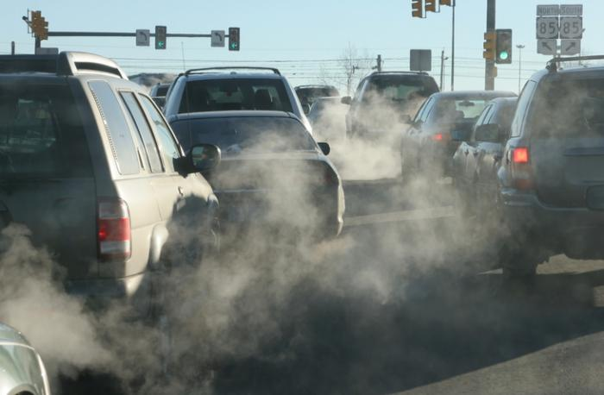
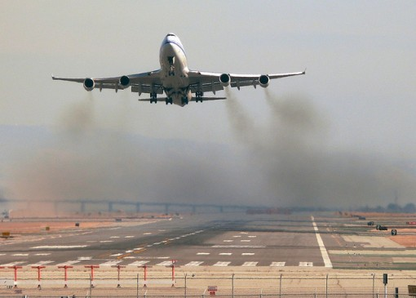
Introduction
Air pollution is a serious problem in the world right now.
Hazardous air pollutants/toxic air pollutants/air toxics are poisonous for human body.
Cause serious health problems
This dataset is from the Environmental Protection Agency (EPA) tracking 187 air pollutants from 1990 to 2017.
Daily summary file, containing data for every monitor in the EPA database.

Slide 4
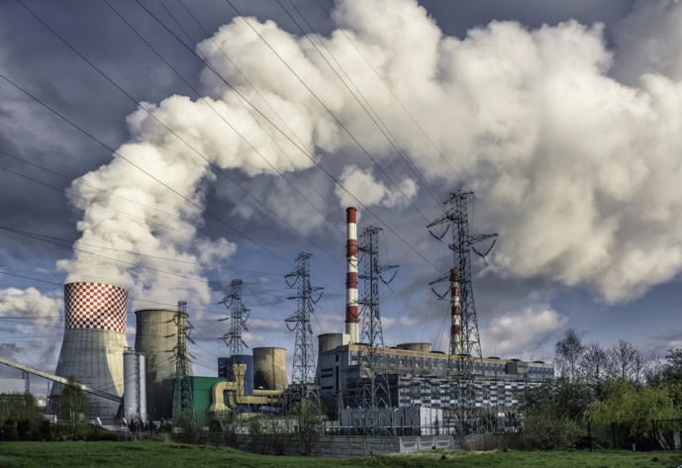
Specification and Perquisites for Hazardous Air Pollutants Dataset
GitHub: https://github.com/sqian2/CIS5200-01-Group-6-Project
Dataset: https://www.kaggle.com/epa/hazardous-air-pollutants
Dataset size: 2.29GB
Number of files: 1 File
File format: CSV file
Cluster version: IOP 4.2
Cluster number of nodes: 1 node
Memory: 8 GB
CPU: 4 Cores
CPU Speed: 2.81 GHz

Slide 5
Goals and Objective
Determine which air pollutants are measured the most
Determine which cities have the highest and lowest air pollutants measured
Determine which states have the highest and lowest air pollutants measured
Determine which dates have the highest and lowest air pollutants measured
Express the amount of air pollutants caused from these last 27 years from 1990 to 2017

Slide 6





Implementation
Raw data from Kaggle.com
Stored onto HDFS
Analysis on Hive
Transfer Data using WINSCP
Reporting on Tableau

Slide 7
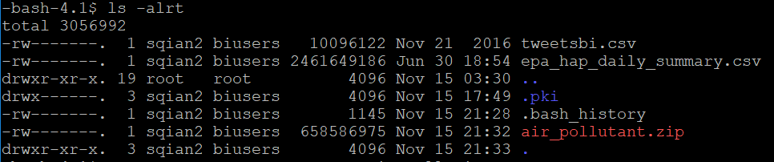
Air Pollutants Data Loaded into BigInsights
Create account on Google drive, and upload zip file
Download file on HDFS, and unzip

Slide 8
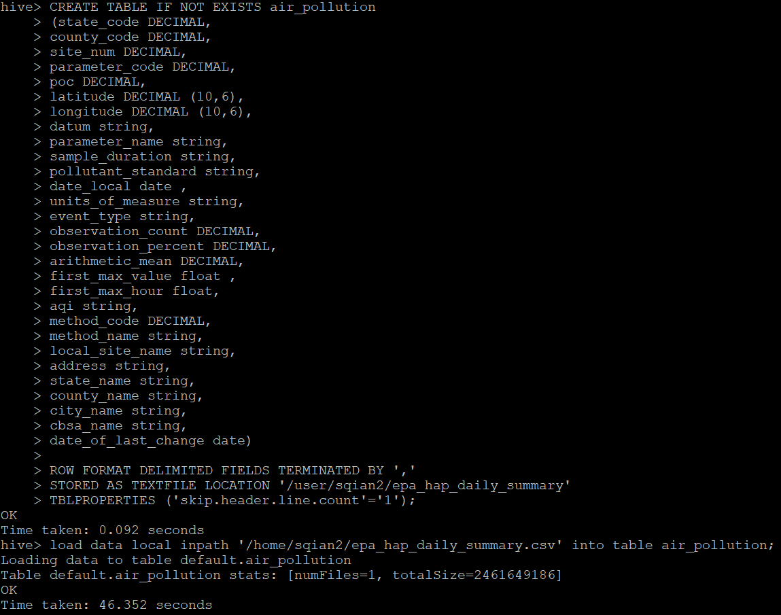
Create Hive table to Query Air Pollutants Data
CREATE TABLE IF NOT EXISTS air_pollution (state_code DECIMAL, county_code DECIMAL, site_num DECIMAL, parameter_code DECIMAL, poc DECIMAL, latitude DECIMAL (10,6), longitude DECIMAL (10,6), datum string, parameter_name string, sample_duration string, pollutant_standard string, date_local date, units_of_measure string, event_type string, observation_count DECIMAL, observation_percent DECIMAL, arithmetic_mean DECIMAL, first_max_value float, first_max_hour float, aqi string, method_code DECIMAL, method_name string, local_site_name string, address string, state_name string, county_name string, city_name string, cbsa_name string, date_of_last_change date) ROW FORMAT DELIMITED FIELDS TERMINATED BY ',' STORED AS TEXTFILE LOCATION '/user/sqian2/epa_hap_daily_summary‘ TBLPROPERTIES ('skip.header.line.count'='1');
load data local inpath '/home/sqian2/epa_hap_daily_summary.csv' into table air_pollution;

Slide 9
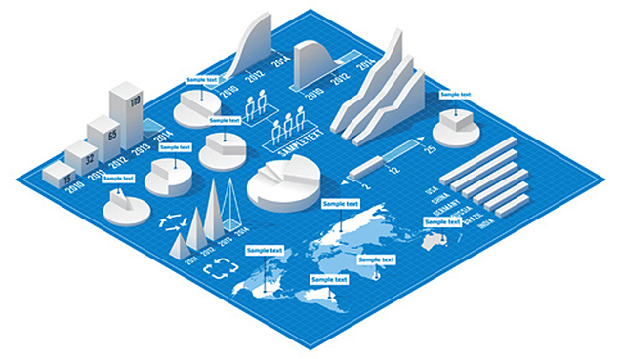
Visualization

Slide 10
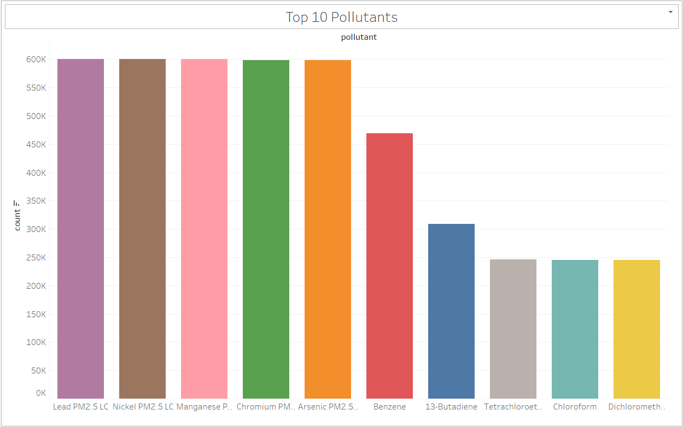
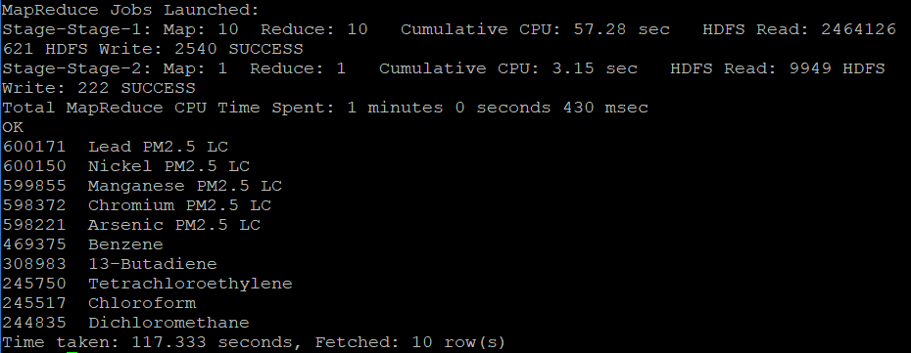
1. Top 10 Pollutants
Query to find which 10 pollutants have appeared the most

Slide 11
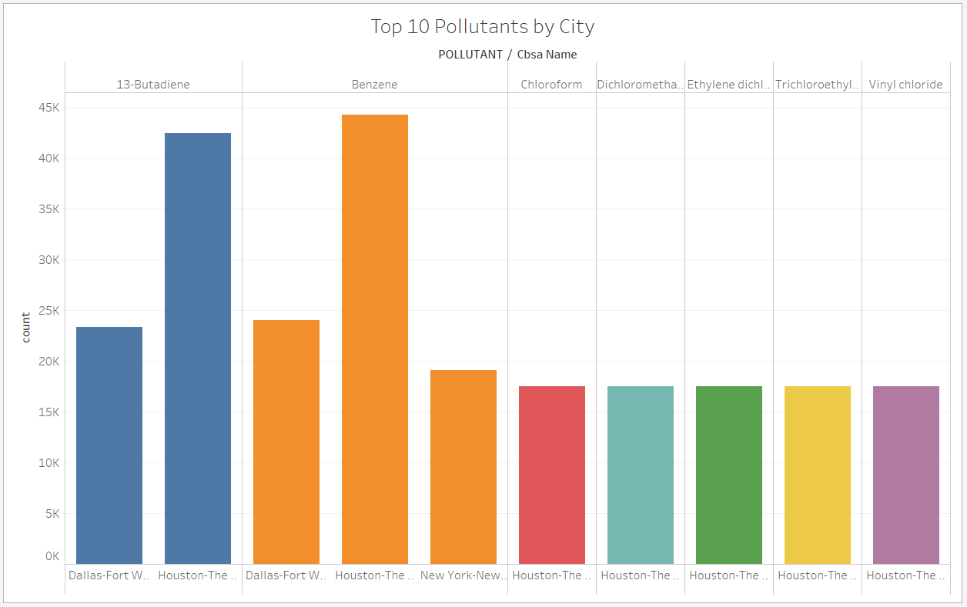
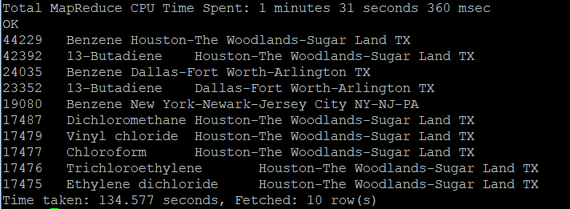
2. Top 10 Pollutants by City
Query to find which 10 pollutants have appeared the most by city

Slide 12
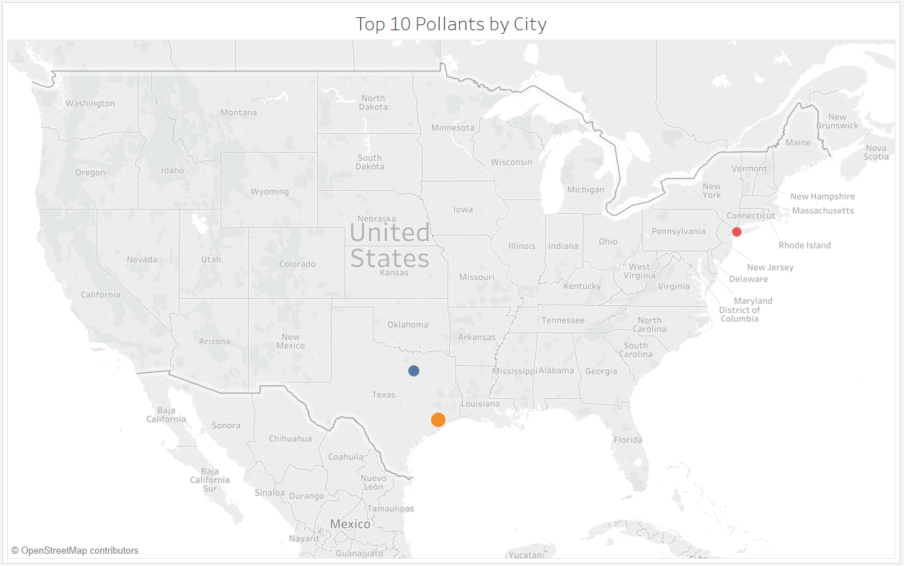

Slide 13
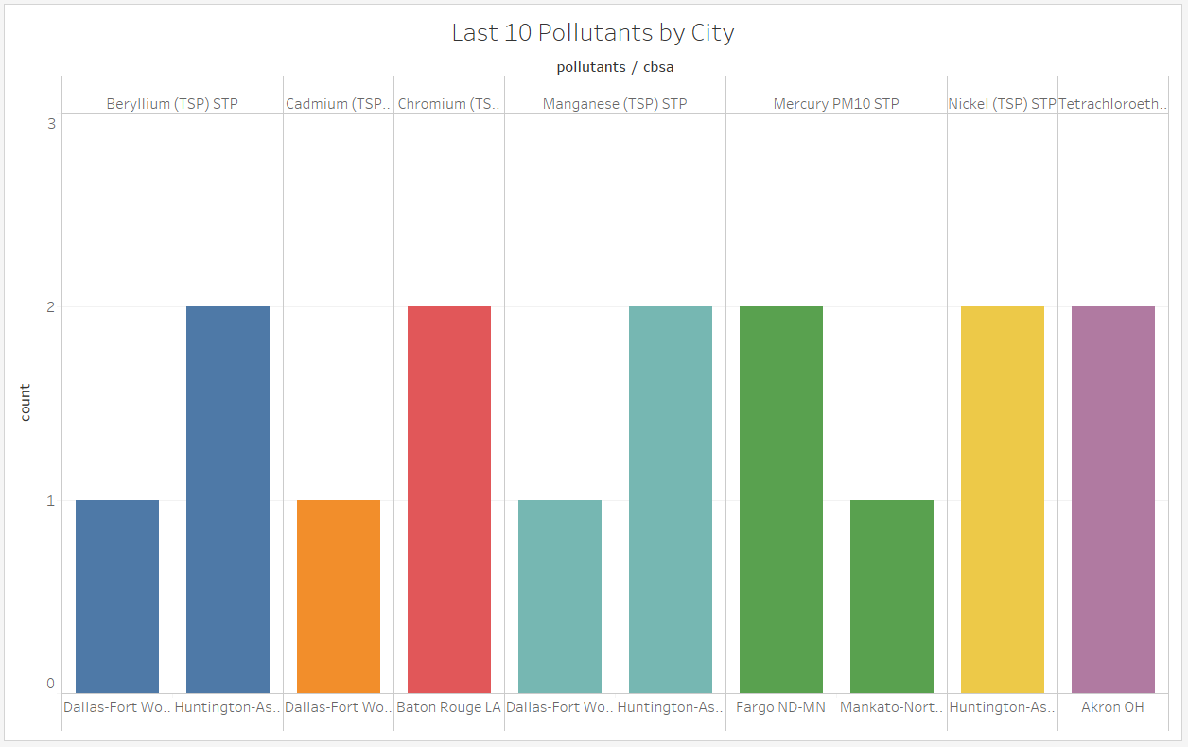
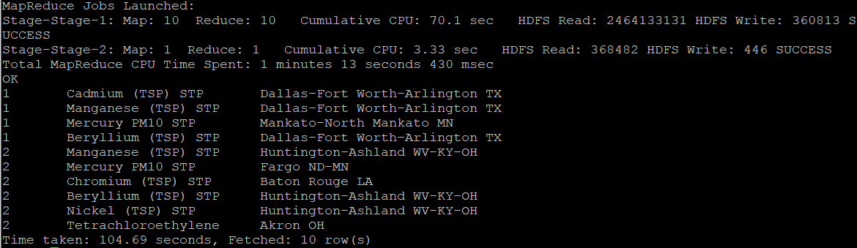
3. Last 10 Pollutants by City
Query to find which 10 pollutants have appeared the least by city

Slide 14
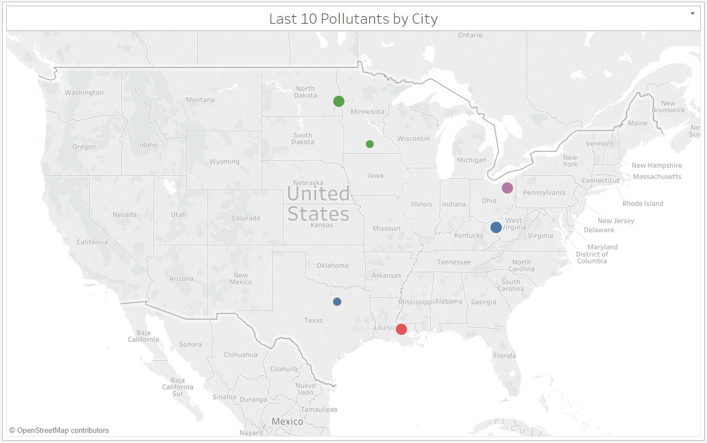

Slide 15
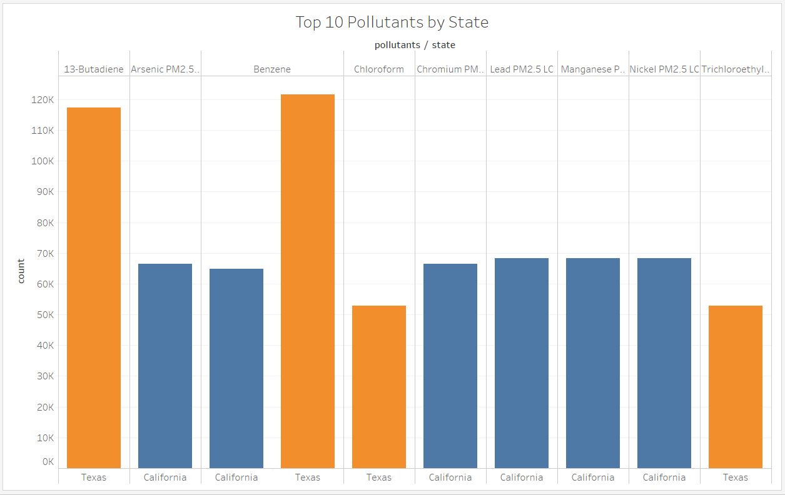
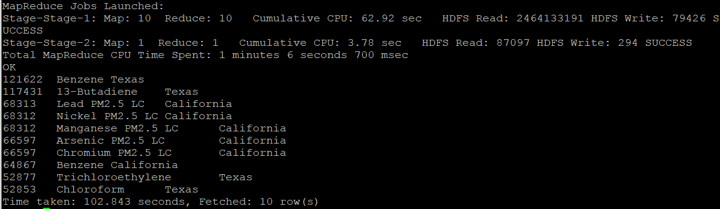
4. Top 10 Pollutants by State
Query to find which 10 pollutants have appeared the most by state

Slide 16
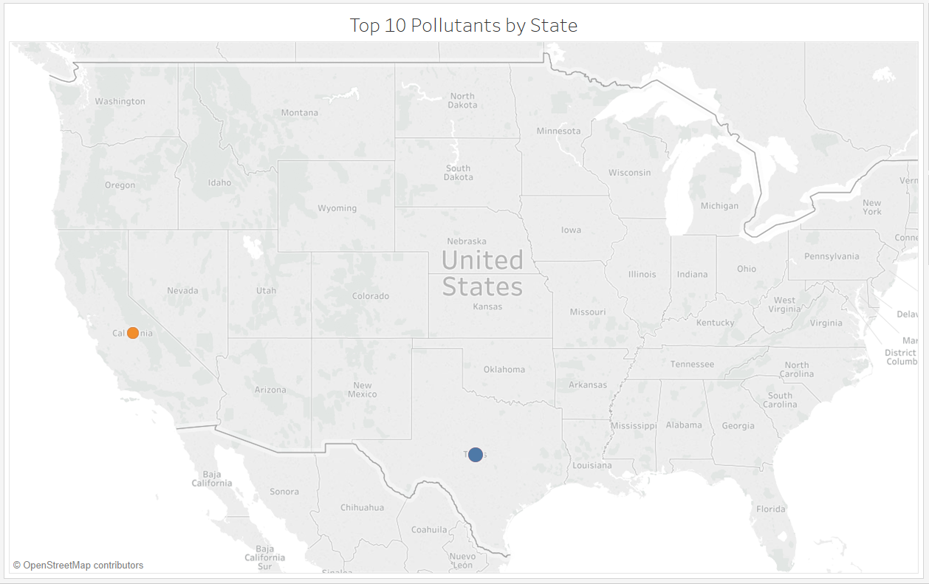

Slide 17
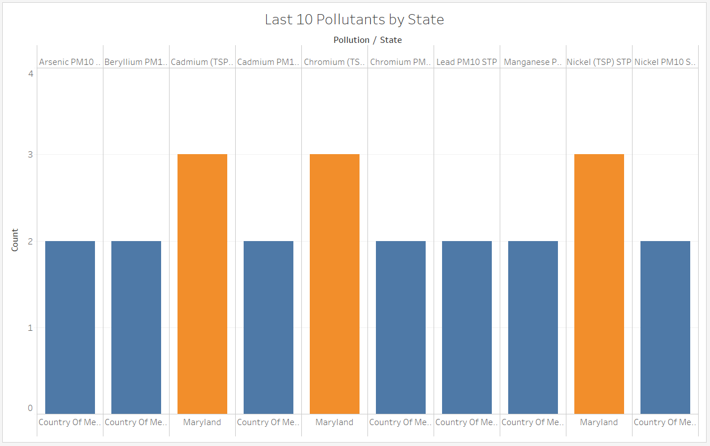
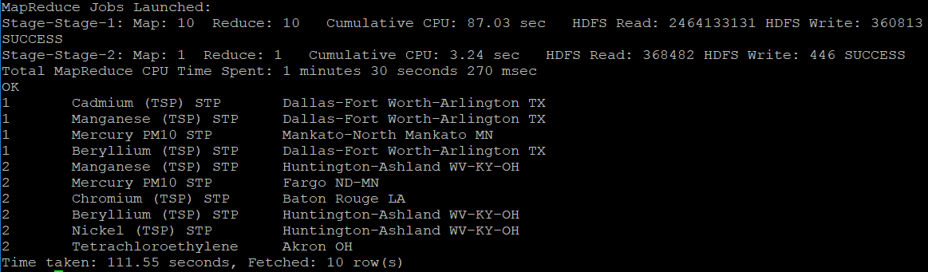
5. Last 10 Pollutants by State
Query to find which 10 pollutants have appeared the least by state

Slide 18
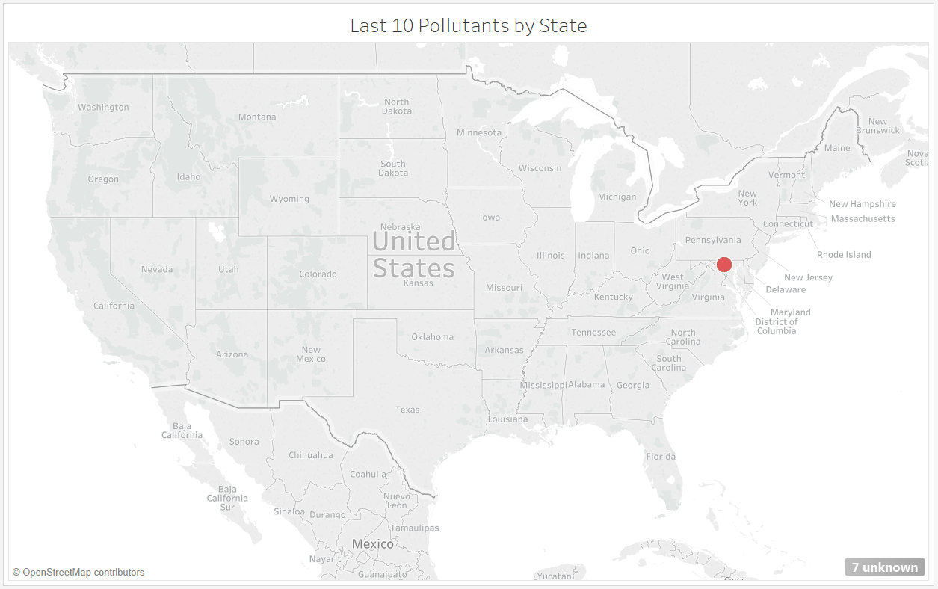

Slide 19
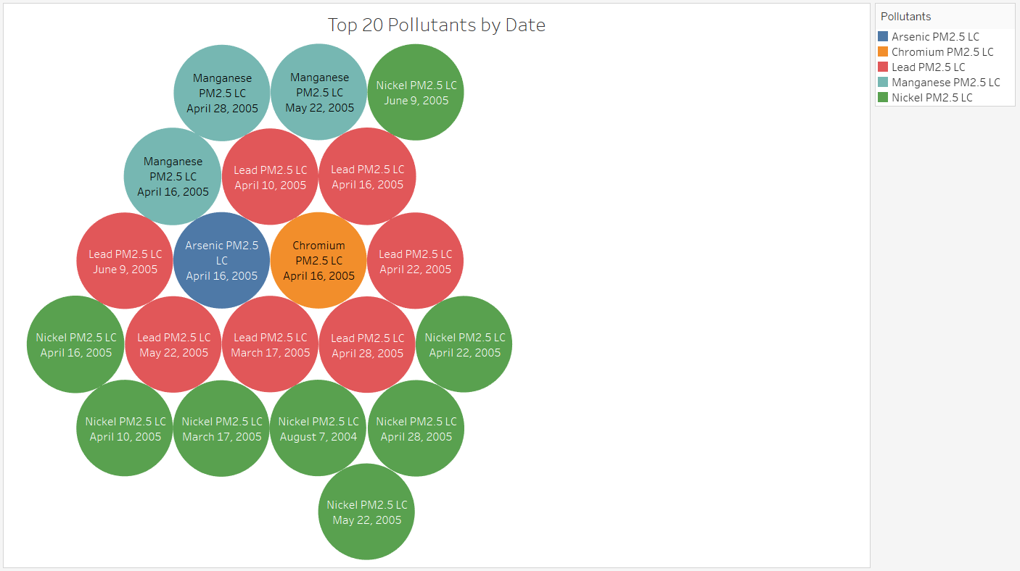
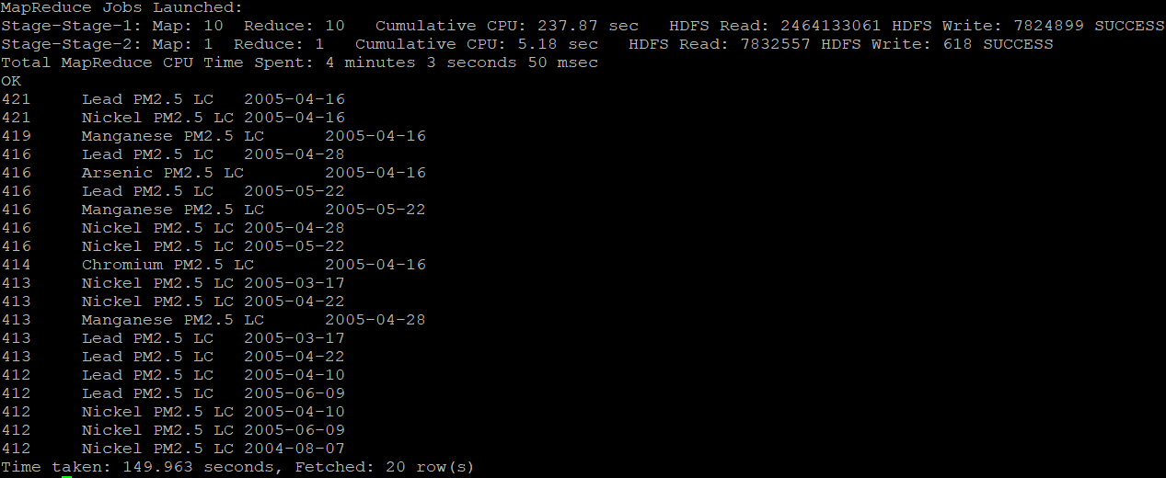
6. Top 20 Pollutants by Date
Query to find which 20 pollutants have appeared the most by date

Slide 20
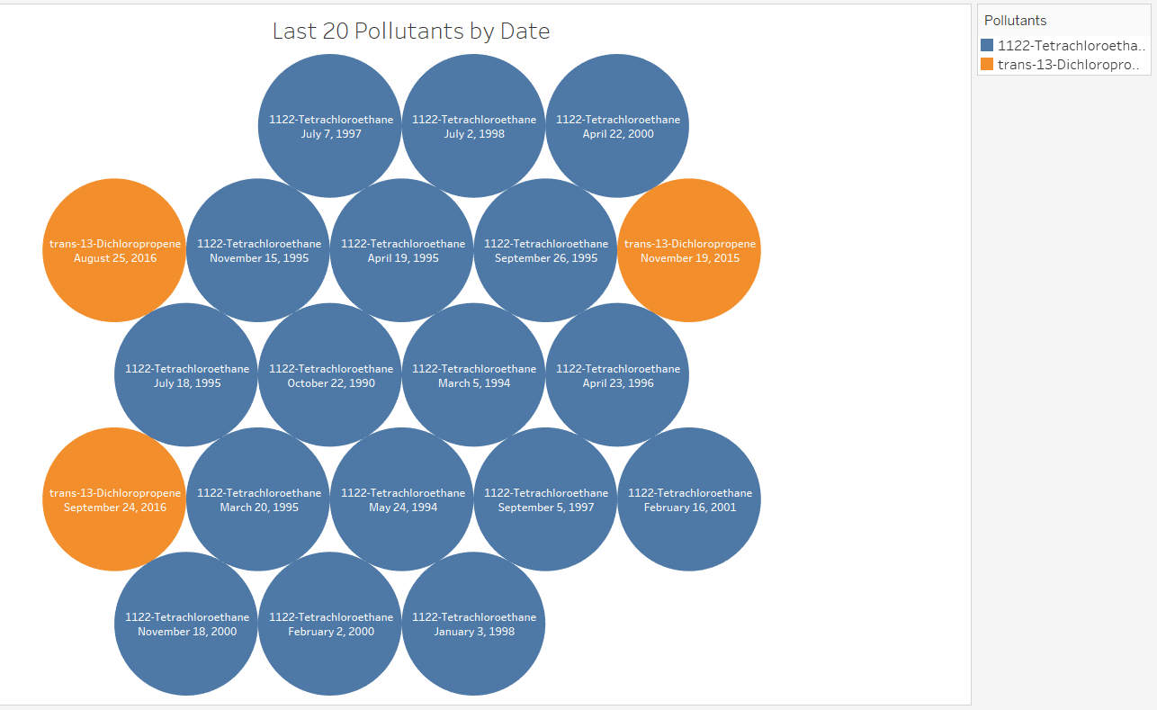
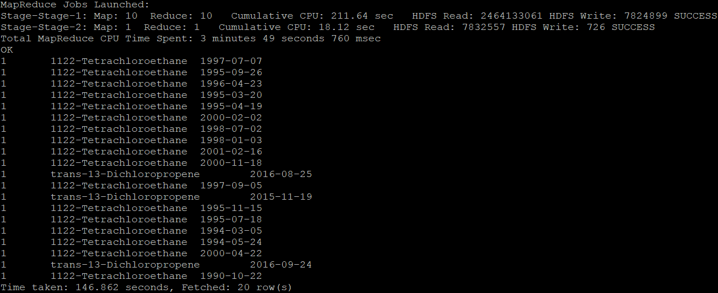
7. Last 20 Pollutants by Date
Query to find which 20 pollutants have appeared the least by date

Slide 21

Challenges
While uploading data manually into Ambari, we were not able to see the data fields in the terminal. We have overcame this difficulty by generating the link through google drive of the dataset.
While creating the table, we had difficulty by setting the decimal as a datatype for the longitude and latitude field, then after we set the parameter for the decimal data type and finally we were able to see the co-ordinates as it is mentioned in the raw data.
We used Tableau for visualization rather than MS Excel because we were able to generate separate representation.

Slide 22

Conclusion
Air Pollutants across the United States between 1990 till 2017 was analyzed based on several aspects and documented accordingly in Hive using IBM BlueInsights.
Geo Maps and Various Chart representations were included for a better understanding of the Dataset.

Slide 23
Links and References
Dataset: https://www.kaggle.com/epa/hazardous-air-pollutants
GitHub: https://github.com/sqian2/CIS5200-01-Group-6-Project
CIS 5200 Lab – Hive Twitter Sentiment Data Analysis using BigInsights of Bluemix: https://app.box.com/file/96513790564
CIS 5200 Lab – Analyzing social media and customer sentiment with IBM analytics engine and Tableau: https://app.box.com/file/247447839736
Hive SQL Syntax Checker: https://sql.treasuredata.com/

Slide 24
Thank You

